Slide 1
eps | minpts | noise points | value counts
1.8 | 9 | 183 | [977, 16]
1.8 | 10 | 195 | [968, 13]
1.8 | 11 | 209 | [954, 13]
1.8 | 12 | 209 | [945, 13]
1.9 | 9 | 128 | [1048]
1.9 | 10 | 134 | [1042]
1.9 | 11 | 158 | [1003, 15]
1.9 | 12 | 166 | [994, 16]
 | Age
count | 1176
mean | 37.199000
std | 9.015802
min | 18.000000
25% | 30.000000
50% | 36.000000
75% | 43.000000
max | 60.000000
 | Enviroment Satisfaction(%) | Job Involvement (%) | Job Satisfaction (%) | Performance Rating (%) | Relationship Satisfaction (%) | Worklife Balance (%)
Low | 19.2177 | 5.5272 | 19.9830 | 00.0000 | 19.3878 | 5.6973
Medium | 19.8129 | 25.7653 | 19.9830 | 00.0000 | 20.7483 | 23.1293
High | 29.8469 | 58.3333 | 29.8469 | 84.7784 | 30.1020 | 61.0544
Excellent | 31.1224 | 10.3741 | 30.1871 | 15.2216 | 29.7619 | 10.1190

Slide 2
val | class | Distribution (%)
1 | Below college | 11.8197
2 | College | 19.8980
3 | Bachelor | 39.0306
4 | Master | 26.5306
5 | Doctor | 2.7211
JobRole | Distribution (%)
Sales Executive | 22.1939
Research Scientist | 20.4082
Laboratory Technician | 18.0272
Manufacturing Director | 9.7789
Healtcare Rapresentative | 9.0136
Manager | 6.8878
Sales Rapresentative | 5.8673
Research Director | 4.3367
Human Resource | 3.4864
JobLevel | Distribution (%)
1 | 37.925
2 | 36.479
3 | 14.881
4 | 6.972
5 | 3.741

Slide 3
 | HourlyRate | DailyRate | MonthlyRate | MonthlyIncome | PercentSalaryHike
count | 1176 | 1176 | 1176 | 963 | 1176
mean | 66.2993 | 803.6505 | 14395.8367 | 6565.9460 | 15.1768
std | 20.2661 | 406.6830 | 7111.8451 | 4710.6256 | 3.6239
min | 30.0000 | 102.0000 | 2097.0000 | 1009.0000 | 11.0000
25% | 49.0000 | 460.5000 | 8227.2500 | 2969.0000 | 12.0000
50% | 66.0000 | 804.0000 | 14434.0000 | 4969.0000 | 14.0000
75% | 84.0000 | 1169.0000 | 20489.2500 | 8585.0000 | 18.0000
max | 100.0000 | 1499.0000 | 26999.0000 | 19999.0000 | 25.0000
 | MonthlyIncomeTransf
count | 1176
mean | 8.59
std | 0.61
min | 6.91
25% | 8.14
50% | 8.56
75% | 8.98
max | 9.90
Attribute | Age | Business Travel | Gender | Monthly Income | Over18 | Performance Rating | Standard Hours | TrainingTime LastYear | YearsAt Company
Missing Values | 176 | 107 | 59 | 213 | 372 | 138 | 570 | 233 | 60

Slide 4
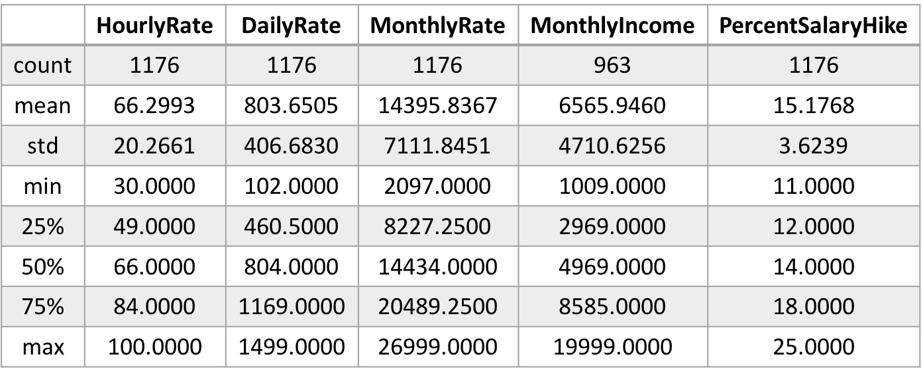
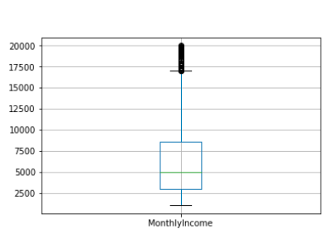



Attribute | Monthly Income | NumCompanies Worked | TotalWorking Year | TrainingTimes LastYear | YearsAt Company | YearsIn CurrentRole | YearsSince LastPromotion | YearsWith CurrManager
Outliers | 89 | 40 | 49 | 152 | 75 | 17 | 85 | 11
Thresholds Q1-1.5*IQR, Q3+1.5*IQR | [-3343.875, 14775.125] | [-3.5, 8.5] | [-7.5, 28.5] | [0.5,4.5] | [-6.0, 18.0] | [-5.5, 14.5] | [-4.5, 7.5] | [-5.5, 14.5]
Domain | [0, 19999] | [0, 9] | [0, 40] | [0, 6] | [0, 40] | [0, 18] | [0, 15] | [0, 17]

Slide 5
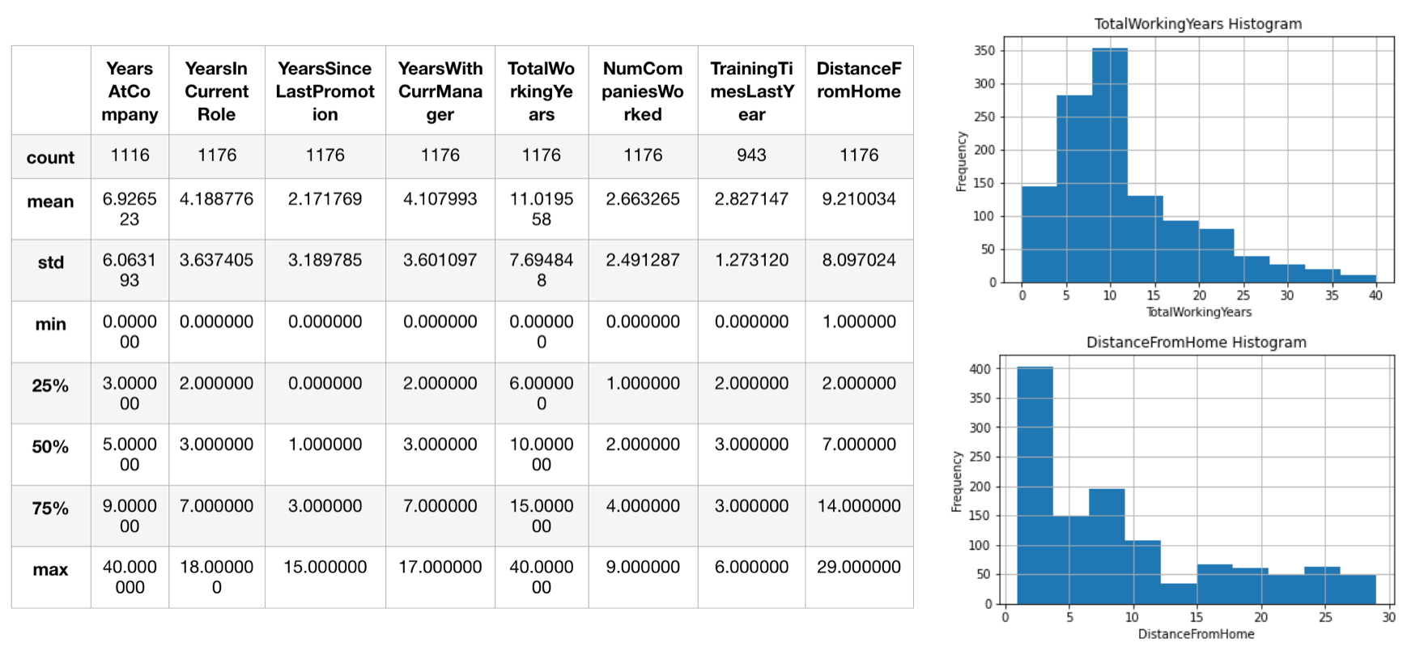
 | YearsAt Company | YearsIn CurrentRole | YearsSince LastPromotion | YearsWithCurr Manager | TotalWorking Years | NumCompanies Worked | TrainingTimes LastYear | Distance FromHome
count | 1116 | 1176 | 1176 | 1176 | 1176 | 1176 | 943 | 1176
mean | 6.9265 | 4.1887 | 2.1717 | 4.1079 | 11.0195 | 2.6632 | 2.8271 | 9.2100
std | 6.0631 | 3.6374 | 3.1897 | 3.6010 | 7.6948 | 2.4912 | 1.2731 | 8.0970
min | 0.0000 | 0.0000 | 0.0000 | 0.0000 | 0.0000 | 0.0000 | 0.0000 | 1.0000
25% | 3.0000 | 2.0000 | 0.0000 | 2.0000 | 6.0000 | 1.0000 | 2.0000 | 2.0000
50% | 5.0000 | 3.0000 | 1.0000 | 3.0000 | 10.0000 | 2.0000 | 3.0000 | 7.0000
75% | 9.0000 | 7.0000 | 3.0000 | 7.0000 | 15.0000 | 4.0000 | 3.0000 | 14.0000
max | 40.0000 | 18.0000 | 15.0000 | 17.0000 | 40.0000 | 9.0000 | 6.0000 | 29.0000

Slide 6
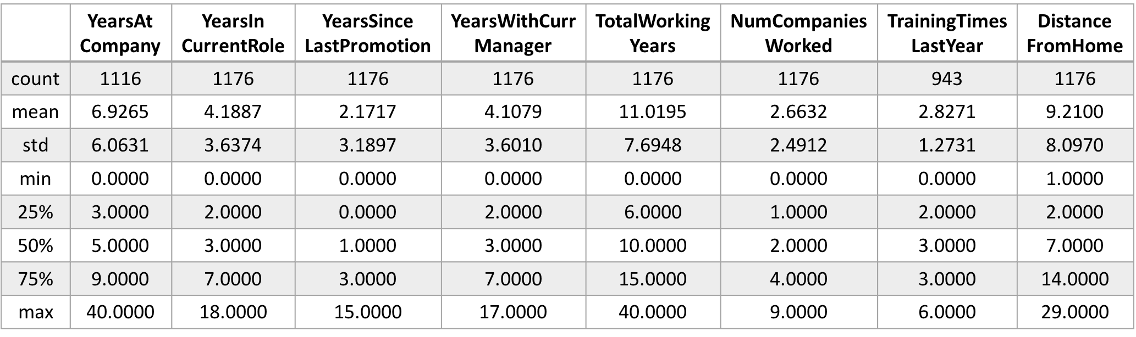

Slide 7
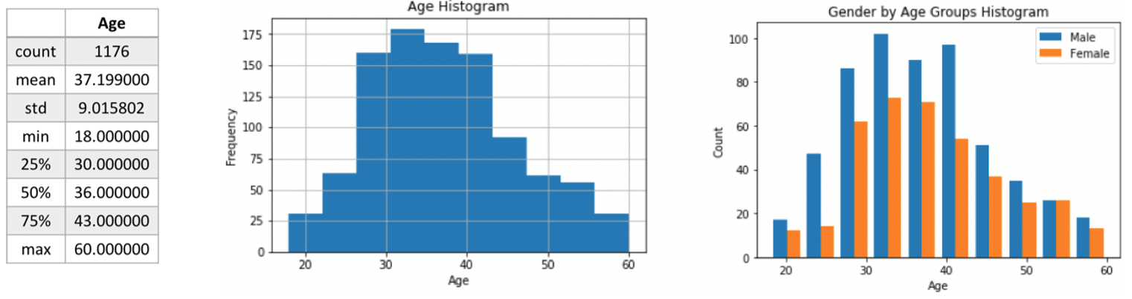

Slide 8
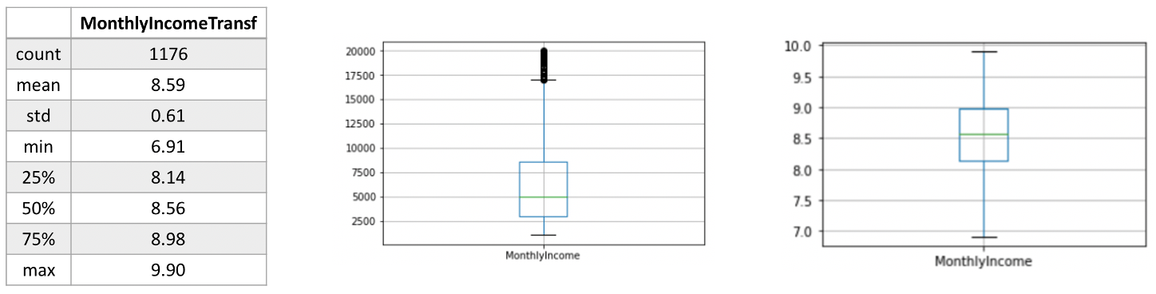

Slide 9
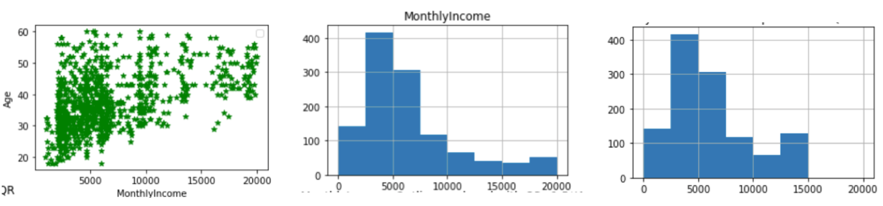

Slide 10
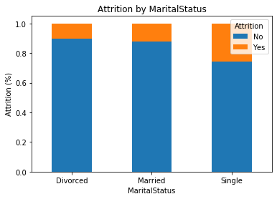
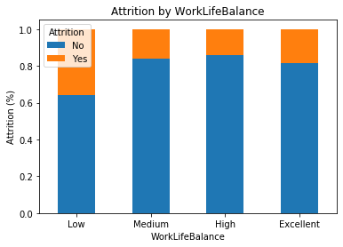
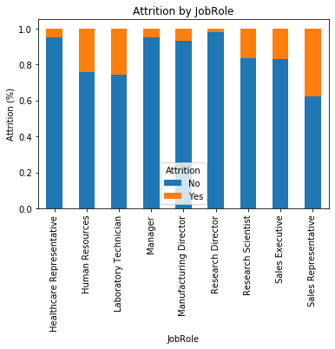
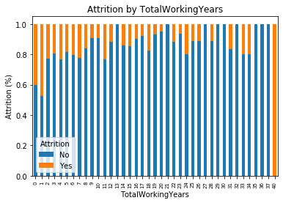

Slide 11
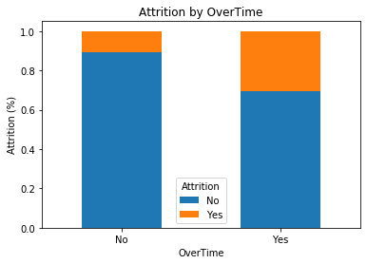

Slide 12
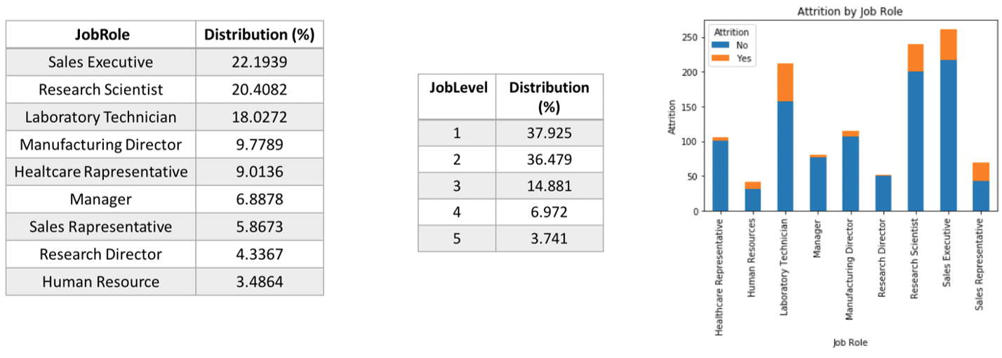

Slide 13
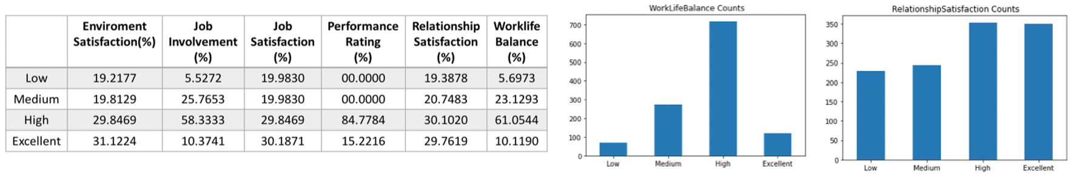

Slide 14
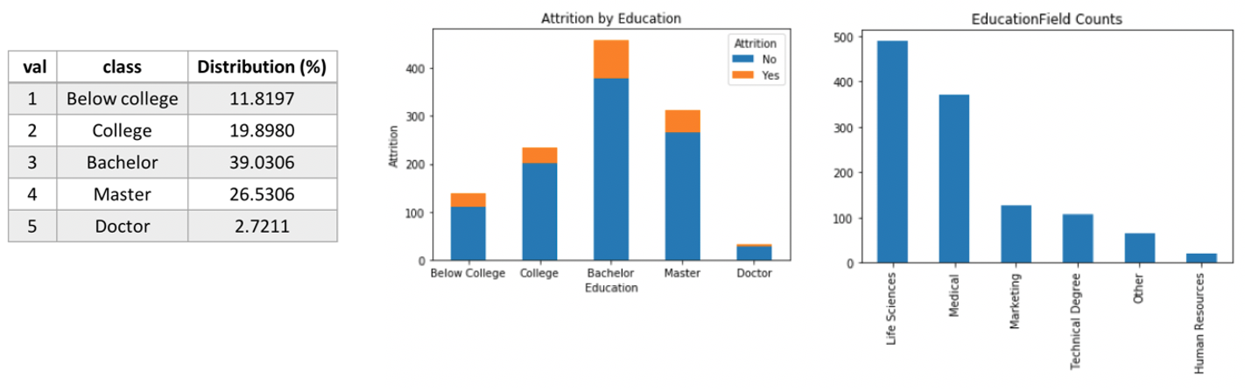

Slide 15
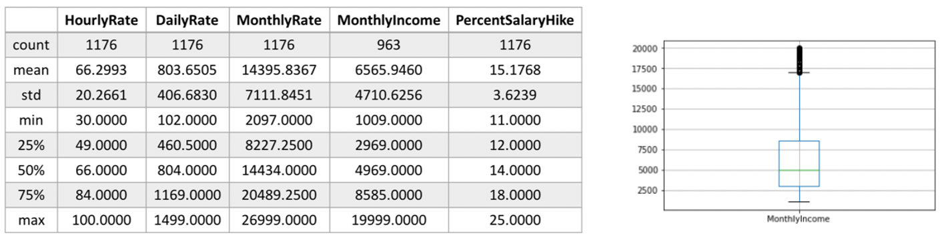

Slide 16
Clustering Technique | Clustering Quality | Silhouette Value | Number of cluster | Distance metric
K-Means | Excellent | 0.6489 | 6 | euclidean
DBScan | Poor | 0.5859 | 1 | euclidean
Hierarchical | Good | 0.5094 | 3 | euclidean

Slide 17
ODT Test Set | Predicted Class
Actual Class |  | Class = ‘No’ | Class = ‘Yes’
 | Class = ‘No’ | 234 (TP) | 15 (FN)
 | Class = ‘Yes’ | 29 (FP) | 16 (TN)
RF Test set | Predicted Class
Actual Class |  | Class = ‘No’ | Class = ‘Yes’
 | Class = ‘No’ | 245 (TP) | 4 (FN)
 | Class = ‘Yes’ | 39 (FP) | 6 (TN)

Slide 18
max depth | min samples leaf | min samples split | Data Type | Accuracy | Precision | Recall | F-Score
2 | 1 | 2 | Training (4-fold cv) | 0.8512 (+/- 0.03) | 0.8343 (+/- 0.03) | 0.8512 (+/- 0.03) | 0.8265 (+/- 0.06)
 |  |  | Training | 0.8494 | 0.8831 | 0.9451 | 0.9131
 |  |  | Test | 0.8231 | 0.8773 | 0.9196 | 0.8980

Slide 19
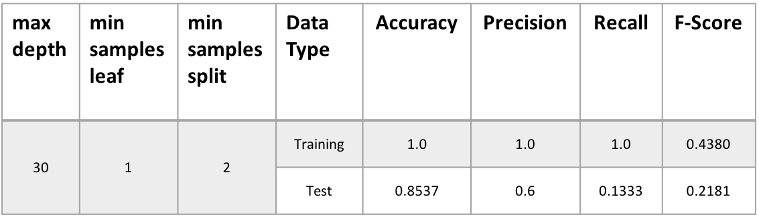
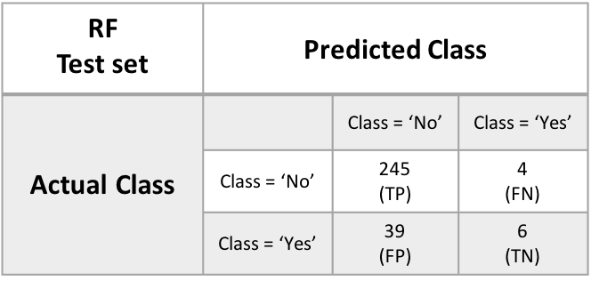
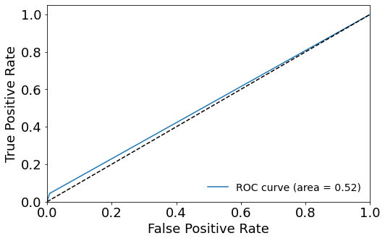
max depth | min samples leaf | min samples split | Data Type | Accuracy | Precision | Recall | F-Score
46 | 1 | 10 | Training (4-fold cv) | 0.8512 (+/- 0.01) | 0.8520 (+/- 0.04) | 0.8529 (+/- 0.02) | 0.7984 (+/- 0.02)
 |  |  | Training | 0.9404 | 0.9335 | 1.0 | 0.9656
 |  |  | Test | 0.8503 | 0.8596 | 0.9839 | 0.9176
KNN k=6 Test set | Predicted Class
Actual Class |  | Class = ‘No’ | Class = ‘Yes’
 | Class = ‘No’ | 247 (TP) | 2 (FN)
 | Class = ‘Yes’ | 43 (FP) | 2 (TN)

Slide 20
Algorithm | Parameters
Grid Search | max_depth | [2:10]
 | min_samples_leaf | [2, 5, 10, 20, 30, 40, 50, 100]
 | min_samples_split | [1, 5, 10, 20, 30, 40, 50, 100]
Randomized Search | max_depth | [2:100]
 | min_samples_leaf | [2, 5, 10, 20, 30, 40, 50, 100, 150, 200]
 | min_samples_split | [1, 5, 10, 20, 30, 40, 50, 100, 150, 200]
Algorithm | Parameters
Random Decision Forest | max_depth | [2:200]
 | min_samples_leaf | [2, 5, 10, 20, 30, 40, 50, 100, 150]
 | min_samples_split | [1, 5, 10, 15, 20, 30, 50, 100, 150]
 | criterion | [‘gini’, ‘entropy’]

Slide 21
Max depth | Min simples leaf | Min samples split | Data Type | Accuracy | Precision | Recall | F-Score
5 6 7 8 9 | 20 20 20 20 20 | [2, 5, 10, 20, 30, 40] [2, 5, 10, 20, 30, 40] [2, 5, 10, 20, 30, 40] [2, 5, 10, 20, 30, 40] [2, 5, 10, 20, 30, 40] | Training (4-fold cv) | 0.8401 (+/- 0.00) | 0.8186 (+/- 0.03) | 0.8401 (+/- 0.00) | 0.8215 (+/- 0.03)
 |  |  | Training | 0.8707 | 0.8902 | 0.9644 | 0.9258
 |  |  | Test | 0.8503 | 0.8897 | 0.9397 | 0.9140
2 2 | 5 40 | 150 10 | Training (4-fold cv) | 0.8495 (+/- 0.03) | 0.8020 (+/- 0.12) | 0.8495 (+/- 0.03) | 0.8212 (+/- 0.07)
 |  |  | Training | 0.8494 | 0.8831 | 0.9451 | 0.9131
 |  |  | Test | 0.8231 | 0.8773 | 0.9196 | 0.8980
11 14 15 39 | 50 50 50 50 | 30 50 50 20 | Training (4-fold cv) | 0.8469 (+/- 0.03) | 0.8246 (+/- 0.05) | 0.8469 (+/- 0.03) | 0.8306 (+/- 0.05)
 |  |  | Training | 0.8545 | 0.8613 | 0.9847 | 0.9189
 |  |  | Test | 0.8401 | 0.8633 | 0.9638 | 0.9108

Slide 22
min samples split | Data Type | Accuracy | Precision | Recall | F-Score
1 | Training (4-fold cv) | 0.8512 (+/- 0.03) | 0.6182 (+/- 0.18) | 0.3021 (+/- 0.30) | 0.6438 (+/- 0.16)
 | Training | 0.8494 | 0.5609 | 0.3593 | 0.4380
 | Test | 0.8231 | 0.8231 | 0.3939 | 0.3333
2
3
4

Slide 23
K | Data Type | Accuracy | Precision | Recall | F-Score
1 | Training (4-fold cv) | 0.7355 (+/- 0.05) | 0.7407 (+/- 0.04) | 0.7355 (+/- 0.05) | 0.7378 (+/- 0.04)
 | Training | 1.0 | 1.0 | 1.0 | 1.0
 | Test | 0.7619 | 0.8565 | 0.8634 | 0.86
2 | Training (4-fold cv) | 0.8189 (+/- 0.02) | 0.7404 (+/- 0.06) | 0.8189 (+/- 0.02) | 0.7629 (+/- 0.02)
 | Training | 0.8724 | 0.8677 | 1.0 | 0.9291
 | Test | 0.8299 | 0.8515 | 0.9678 | 0.9060
3 | Training (4-fold cv) | 0.7951 (+/- 0.04) | 0.7457 (+/- 0.04) | 0.7951 (+/- 0.04) | 0.7624 (+/- 0.03)
 | Training | 0.8741 | 0.8884 | 0.9715 | 0.9281
 | Test | 0.8095 | 0.8534 | 0.9357 | 0.8927
4 | Training (4-fold cv) | 0.8240 (+/- 0.02) | 0.7338 (+/- 0.08) | 0.8240 (+/- 0.02) | 0.7604 (+/- 0.02)
 | Training | 0.8511 | 0.8538 | 0.9918 | 0.9177
 | Test | 0.8299 | 0.8515 | 0.9678 | 0.9060
5 | Training (4-fold cv) | 0.8129 (+/- 0.04) | 0.7350 (+/- 0.04) | 0.8129 (+/- 0.04) | 0.7606 (+/- 0.03)
 | Training | 0.8596 | 0.8666 | 0.9837 | 0.9214
 | Test | 0.8333 | 0.8597 | 0.9598 | 0.9070
6 | Training (4-fold cv) | 0.8342 (+/- 0.01) | 0.7503 (+/- 0.07) | 0.8342 (+/- 0.01) | 0.7684 (+/- 0.01)
 | Training | 0.8392 | 0.8417 | 0.9949 | 0.9119
 | Test | 0.8469 | 0.8517 | 0.9919 | 0.9165
K | Data Type | Accuracy | Precision | Recall | F-Score
7 | Training (4-fold cv) | 0.8299 (+/- 0.02) | 0.7814 (+/- 0.11) | 0.8299 (+/- 0.02) | 0.7675 (+/- 0.01)
 | Training | 0.8460 | 0.8482 | 0.9939 | 0.9153
 | Test | 0.8367 | 0.8501 | 0.9799 | 0.9104
8 | Training (4-fold cv) | 0.8333 (+/- 0.01) | 0.6997 (+/- 0.00) | 0.8333 (+/- 0.01) | 0.7607 (+/- 0.00)
 | Training | 0.8375 | 0.8385 | 0.9979 | 0.9113
 | Test | 0.8469 | 0.8493 | 0.9959 | 0.9168
9 | Training (4-fold cv) | 0.8316 (+/- 0.01) | 0.7514 (+/- 0.14) | 0.8316 (+/- 0.01) | 0.7629 (+/- 0.01)
 | Training | 0.8392 | 0.8412 | 0.9959 | 0.9120
 | Test | 0.8435 | 0.8487 | 0.9919 | 0.9148
10 | Training (4-fold cv) | 0.8350 (+/- 0.01) | 0.6999 (+/- 0.00) | 0.8350 (+/- 0.01) | 0.7615 (+/- 0.00)
 | Training | 0.8392 | 0.8394 | 0.9989 | 0.9122
 | Test | 0.8469 | 0.8493 | 0.9959 | 0.9168
11 | Training (4-fold cv) | 0.8350 (+/- 0.01) | 0.6999 (+/- 0.00) | 0.8350 (+/- 0.01) | 0.7615 (+/- 0.00)
 | Training | 0.8367 | 0.8390 | 0.9959 | 0.9107
 | Test | 0.8469 | 0.8493 | 0.9959 | 0.9168
12 | Training (4-fold cv) | 0.8359 (+/- 0.00) | 0.7000 (+/- 0.00) | 0.8359 (+/- 0.00) | 0.7619 (+/- 0.00)
 | Training | 0.8367 | 0.8373 | 0.9989 | 0.9111
 | Test | 0.8469 | 0.8469 | 1.0 | 0.9171

Slide 24
K | Data Type | Accuracy | Precision | Recall | F-Score
1 | Training (4-fold cv) | 0.7355 (+/- 0.05) | 0.7407 (+/- 0.04) | 0.7355 (+/- 0.05) | 0.7378 (+/- 0.04)
 | Test | 0.7619 | 0.8565 | 0.8634 | 0.86
2 | Training (4-fold cv) | 0.8189 (+/- 0.02) | 0.7404 (+/- 0.06) | 0.8189 (+/- 0.02) | 0.7629 (+/- 0.02)
 | Test | 0.8299 | 0.8515 | 0.9678 | 0.9060
3 | Training (4-fold cv) | 0.7951 (+/- 0.04) | 0.7457 (+/- 0.04) | 0.7951 (+/- 0.04) | 0.7624 (+/- 0.03)
 | Test | 0.8095 | 0.8534 | 0.9357 | 0.8927
4 | Training (4-fold cv) | 0.8240 (+/- 0.02) | 0.7338 (+/- 0.08) | 0.8240 (+/- 0.02) | 0.7604 (+/- 0.02)
 | Test | 0.8299 | 0.8515 | 0.9678 | 0.9060
5 | Training (4-fold cv) | 0.8129 (+/- 0.04) | 0.7350 (+/- 0.04) | 0.8129 (+/- 0.04) | 0.7606 (+/- 0.03)
 | Test | 0.8333 | 0.8597 | 0.9598 | 0.9070
6 | Training (4-fold cv) | 0.8342 (+/- 0.01) | 0.7503 (+/- 0.07) | 0.8342 (+/- 0.01) | 0.7684 (+/- 0.01)
 | Test | 0.8469 | 0.8517 | 0.9919 | 0.9165
K | Data Type | Accuracy | Precision | Recall | F-Score
7 | Training (4-fold cv) | 0.8299 (+/- 0.02) | 0.7814 (+/- 0.11) | 0.8299 (+/- 0.02) | 0.7675 (+/- 0.01)
 | Test | 0.8367 | 0.8501 | 0.9799 | 0.9104
8 | Training (4-fold cv) | 0.8333 (+/- 0.01) | 0.6997 (+/- 0.00) | 0.8333 (+/- 0.01) | 0.7607 (+/- 0.00)
 | Test | 0.8469 | 0.8493 | 0.9959 | 0.9168
9 | Training (4-fold cv) | 0.8316 (+/- 0.01) | 0.7514 (+/- 0.14) | 0.8316 (+/- 0.01) | 0.7629 (+/- 0.01)
 | Test | 0.8435 | 0.8487 | 0.9919 | 0.9148
10 | Training (4-fold cv) | 0.8350 (+/- 0.01) | 0.6999 (+/- 0.00) | 0.8350 (+/- 0.01) | 0.7615 (+/- 0.00)
 | Test | 0.8469 | 0.8493 | 0.9959 | 0.9168
11 | Training (4-fold cv) | 0.8350 (+/- 0.01) | 0.6999 (+/- 0.00) | 0.8350 (+/- 0.01) | 0.7615 (+/- 0.00)
 | Test | 0.8469 | 0.8493 | 0.9959 | 0.9168
12 | Training (4-fold cv) | 0.8359 (+/- 0.00) | 0.7000 (+/- 0.00) | 0.8359 (+/- 0.00) | 0.7619 (+/- 0.00)
 | Test | 0.8469 | 0.8469 | 1.0 | 0.9171

Slide 25
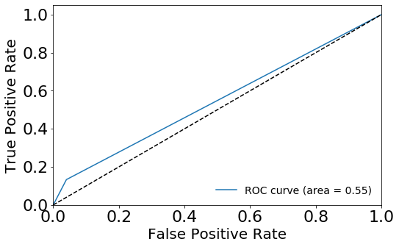
K | Data Type | Accuracy | Precision | Recall | F-Score
7 | Training (4-fold cv) | 0.8299 (+/- 0.02) | 0.7814 (+/- 0.11) | 0.8299 (+/- 0.02) | 0.7675 (+/- 0.01)
 | Training | 0.8460 | 0.8482 | 0.9939 | 0.9153
 | Test | 0.8367 | 0.8501 | 0.9799 | 0.9104
8 | Training (4-fold cv) | 0.8333 (+/- 0.01) | 0.6997 (+/- 0.00) | 0.8333 (+/- 0.01) | 0.7607 (+/- 0.00)
 | Training | 0.8375 | 0.8385 | 0.9979 | 0.9113
 | Test | 0.8469 | 0.8493 | 0.9959 | 0.9168
9 | Training (4-fold cv) | 0.8316 (+/- 0.01) | 0.7514 (+/- 0.14) | 0.8316 (+/- 0.01) | 0.7629 (+/- 0.01)
 | Training | 0.8392 | 0.8412 | 0.9959 | 0.9120
 | Test | 0.8435 | 0.8487 | 0.9919 | 0.9148
10 | Training (4-fold cv) | 0.8350 (+/- 0.01) | 0.6999 (+/- 0.00) | 0.8350 (+/- 0.01) | 0.7615 (+/- 0.00)
 | Training | 0.8392 | 0.8394 | 0.9989 | 0.9122
 | Test | 0.8469 | 0.8493 | 0.9959 | 0.9168
11 | Training (4-fold cv) | 0.8350 (+/- 0.01) | 0.6999 (+/- 0.00) | 0.8350 (+/- 0.01) | 0.7615 (+/- 0.00)
 | Training | 0.8367 | 0.8390 | 0.9959 | 0.9107
 | Test | 0.8469 | 0.8493 | 0.9959 | 0.9168
12 | Training (4-fold cv) | 0.8359 (+/- 0.00) | 0.7000 (+/- 0.00) | 0.8359 (+/- 0.00) | 0.7619 (+/- 0.00)
 | Training | 0.8367 | 0.8373 | 0.9989 | 0.9111
 | Test | 0.8469 | 0.8469 | 1.0 | 0.9171
KNN k=5 Test Set | Predicted Class
Actual Class |  | Class = ‘No’ | Class = ‘Yes’
 | Class = ‘No’ | 239 (TP) | 10 (FN)
 | Class = ‘Yes’ | 39 (FP) | 6 (TN)

Slide 26
